Slide 1
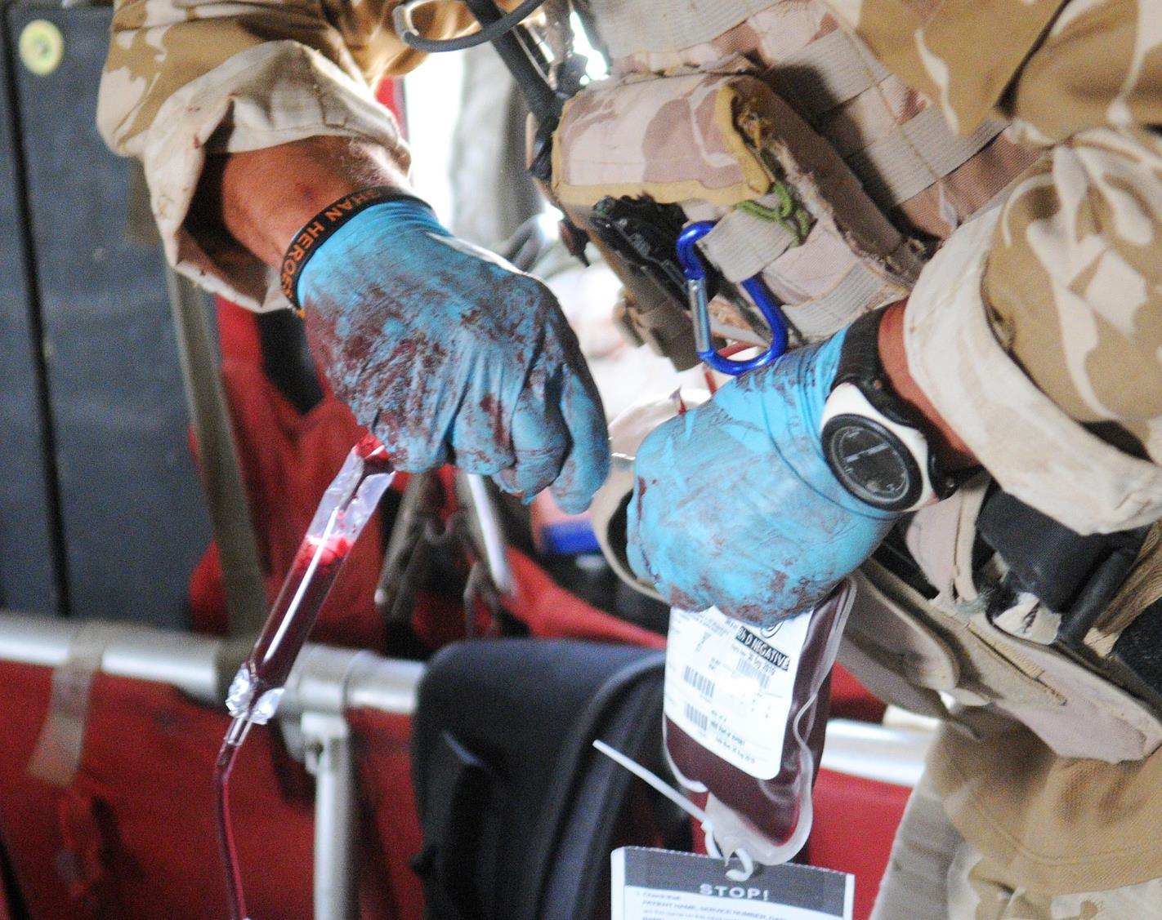
Blood supply in emergencies:
The power of partnership
Heidi Doughty OBE Dr Philos FRCP FRCPath
Consultant in Transfusion Medicine
NHS Blood and Transplant, Birmingham, UK
Honorary Reader, University of Birmingham, UK

Slide 2
Transfusion:
A personal perspective
‘Massive’ Transfusion
Pre-hospital transfusion
Blood Far Forward
Emergency planning
Bloodless surgery and medicine
Notes:
Haematologist
Early convert to clinical transfusion
Interest in supporting bloodless surgery
Military Reservist regularly deployed 2002 – 2012 –
Continued working with the NATO group until 2019
Current interests
Transfusion for trauma
Transfusion Emergency preparedness
Multi-disciplinary team

Slide 3
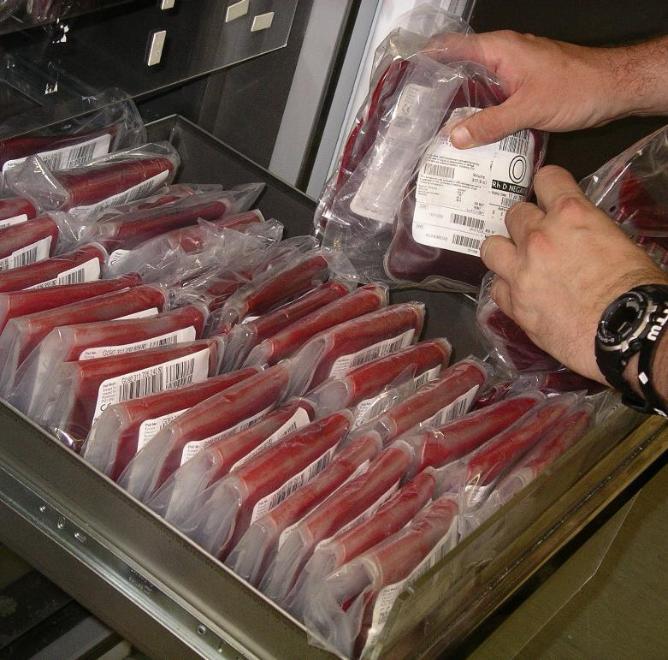
Presentation
Military transfusion
Dealing with Disasters
Lessons from the frontlines
Power of partnership
Notes:
I am going to structure this short presentation into 4 sections
A quick reminder of the recent advances in military transfusion
An introduction to the types of disaster and why it matters
Some examples of how the advances in military medicine have helped
Some final thoughts

Slide 4
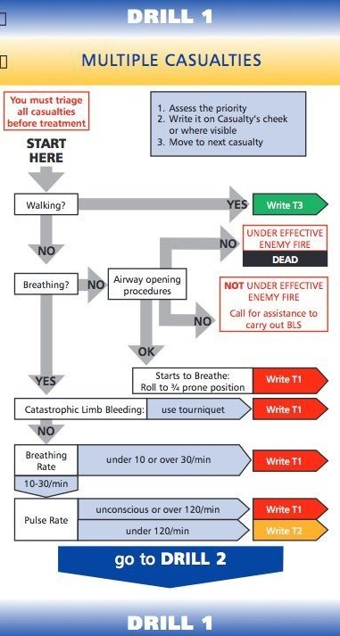
Examples of military influence on civilian transfusion practice
Re-organisation of trauma systems and data collection
Damage control resuscitation with early use of transfusion
Pre-hospital transfusion with improved logistics
Triage, trauma and transfusion support to Emergency Planning
Component research and development for critical bleeding
International collaboration
Malik, Nabeela S. et al. 2021. The BCD Triage Sieve outperforms all existing major incident triage tools: Comparative analysis using the UK national trauma registry population. EClinicalMedicine, Volume 36, 100888. Published:May 14, 2021, DOI:https://doi.org/10.1016/j.eclinm.2021.100888
Notes:
Organisation is key. Introduction of Major Trauma centres in UK, 2010 London, 2012 England
Chris Morans paper in 2018 Changing the System - Major Trauma Patients and Their Outcomes in the
NHS (England) 2008–17
Longitudinal study of 110, 863 patients admitted to 35 hospitals
Improvement of + 0.08 more survivors per 100 each quarter
Notes changes in practice include massive transfusion protocols, TXA, and trauma CT scans
Credits translation of military experience into civilian practice

Slide 5
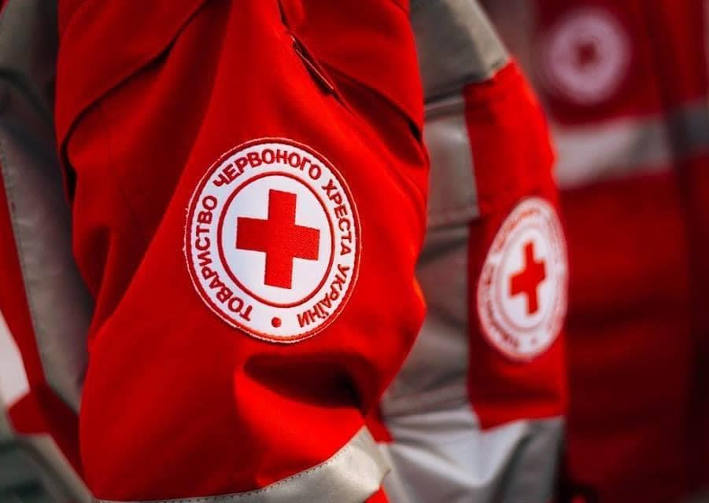
When do Disasters Matter to Transfusion Services?
Disasters matter if they have the potential to :
Cause harm to staff, donors or patients
Increase the demand for blood
Reduce the ability to collect, test, process and distribute blood
Prevent the local population from donating blood
Create a sudden influx of donors
Lead to loss of trust and reputation
Notes:
Not every hazard leads to a disaster, not all disasters concern us however they might if they
Suddenly requires a much larger amount of blood than usual
Temporarily restricts or eliminates a blood collectors ability to collect, test, process and distribute blood
Temporarily restricts or prevents the local population from donating blood or restricts or prevents the use of the available inventory of blood products requiring immediate replacement or re-supply of the region’s blood inventory from another region
Creates a sudden influx of donors requiring accelerated drawing of blood to meet an emergent need elsewhere
I would add – anything that leads to lost of trust and reputation

Slide 6
DEALING with DISASTER
Notes:
Id like to explore so of the factors that could contribute to both delays and errors SHOT report has identified delays

Slide 7
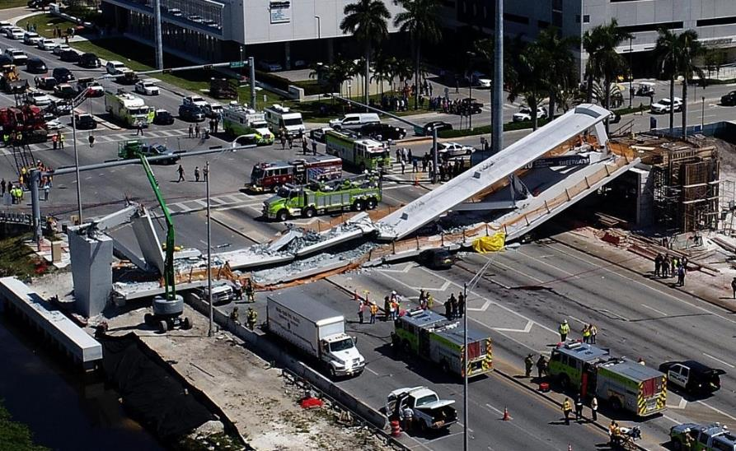
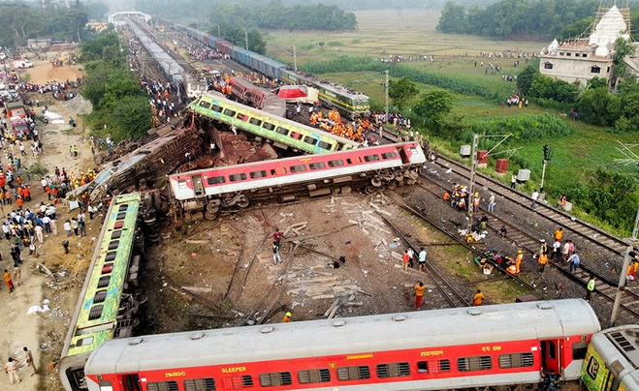
Man-made disasters:
A constant threat
Sociological: Conflict, Terrorism
Technological: Structural collapse, power or ICT failure,
Transportation:
Hazardous materials: Industrial incidents, Pollution
Notes:
Man-made Disasters are events which are caused by man, either intentionally or by accident, which that can directly or indirectly cause severe threats, either directly or indirectly, to public health and/or well-being.
Because their occurrence is unpredictable, man-made disasters pose an especially challenging threat which that must be dealt with through vigilance, and proper preparedness and response.
Information on the major sources of man-made disasters are provided here to help educate the public on their cause and effects as they relate to emergency planning.
Our thoughts go out to those involved in the recent India rail crash that claimed the lives of nearly 300 people and injured more than 800 The derailment of the trains, which happened on Friday evening, was caused by an error in the electronic signalling system
Sociological Hazards
• Terrorism
Terrorism is a controversial term with multiple definitions. One definition means a violent action targeting civilians exclusively. Another definition is the use or threatened use of violence for the purpose of creating fear in order to achieve a political, religious, or ideological goal. Under the second definition, the targets of terrorist acts can be anyone, including civilians, government officials, military personnel, or people serving the interests of governments.
• War
War is conflict, between relatively large groups of people, which involves physical force inflicted by the use of weapons. Warfare has destroyed entire cultures, countries, economies and inflicted great suffering on humanity. Other terms for war can include armed conflict, hostilities, and police action. Acts of war are normally excluded from insurance contracts and disaster planning.
Technological Hazards: Information and communications technology
• Industrial Hazards
Industrial disasters occur in a commercial context, such as mining disasters. They often have an environmental impact.
• Structure Collapse
Structure collapses are often caused by engineering failures. Bridge failures may be caused in several ways, such as under-design etc…
• Power Outage
A power outage is an interruption of normal sources of electrical power. Short-term power outages (up to a few hours) are common and have minor adverse effect, since most businesses and health facilities are prepared to deal with them. Extended power outages, however, can disrupt personal and business activities as well as medical and rescue services, leading to business losses and medical emergencies.

Slide 8
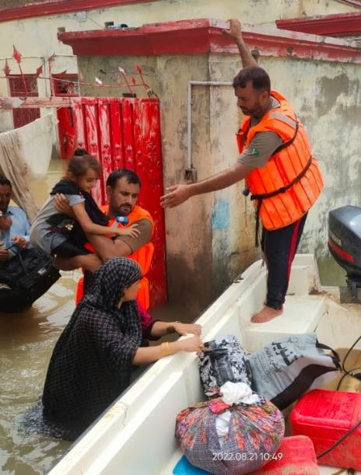
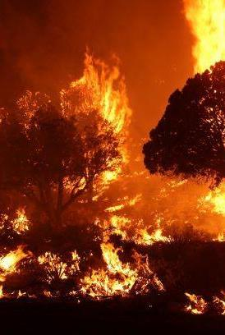
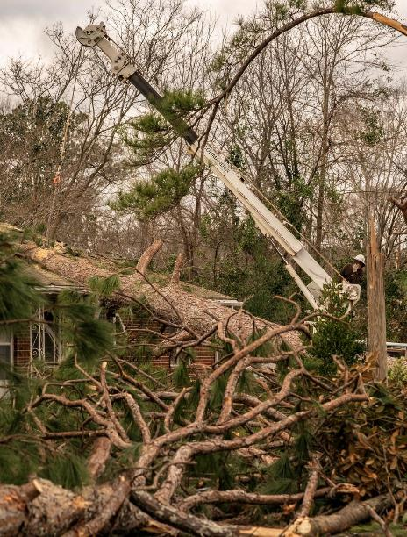
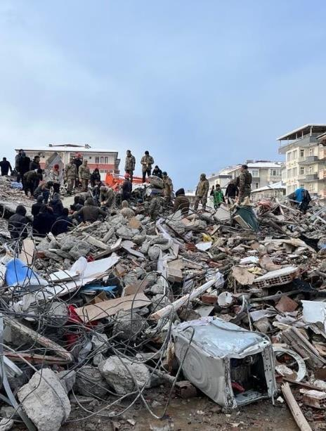
Natural Disasters: A Global issue
Center for Disaster Philanthropy https://disasterphilanthropy.org/disasters/ and https://inciweb.nwcg.gov/incident/photographs/6748/

Slide 9
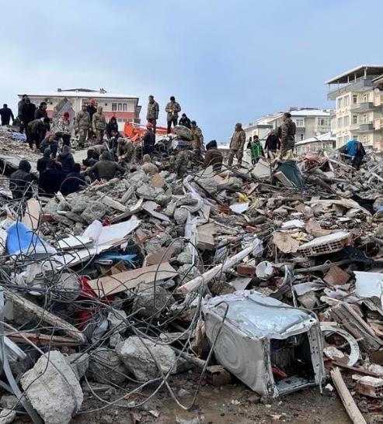
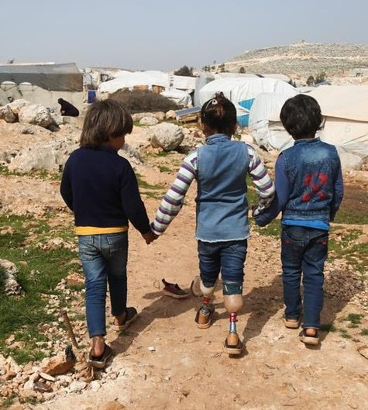
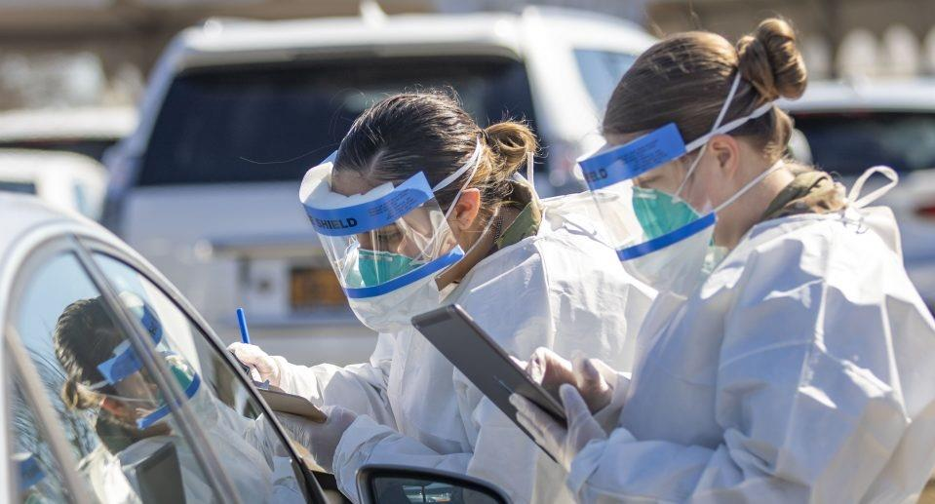
Complex Disasters and Pandemics
Issues affecting transfusion seen in complex humanitarian disasters.
Ongoing demand for blood
Fragmented organisations needing co-ordination
Damage and disruption to infrastructure
Disruption of power supply and communication
Transport and cold chain deficits
Difficulties in maintaining cleanliness and hygiene
Displacement and death of healthcare workers
Shortage of supplies
Economic blockade and sanctions
Notes:
And while there are now fewer large-scale interstate conflicts, other forms of conflict and violence have increased in the past few decades. The complex geopolitical factors involved in these events often trigger long-term humanitarian crises.
The Syrian complex humanitarian emergency is characterized by more than 10 years of ongoing hostilities and their long-term effects, including large-scale internal and cross-border displacement, widespread destruction of civilian infrastructure
In 2023, 15.3 million people need humanitarian assistance. On Feb. 6, 2023, a magnitude 7.8 earthquake occurred in southern Turkey near the northern border of Syria. This quake was followed approximately nine hours later by a magnitude 7.5 earthquake located around 59 miles (95 kilometers) to the southwest. According to ACAPS, new earthquakes are among the worst-case scenarios for the region because they could impact humanitarian needs and the ability to meet them.
In late December 2019, people in Wuhan, China began to get sick with a previously unknown pneumonia, marking the beginning of a new infectious disease, later identified as a new type of coronavirus.

Slide 10
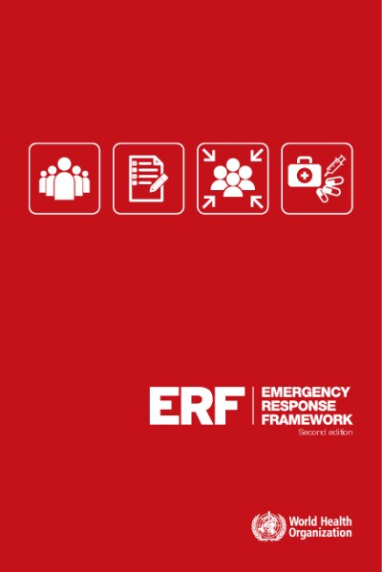
Emergency Planning
Government
Healthcare
Transfusion
Notes:
Most countries or regions have some sort of emergency planning which involves many of the ministries including healthcare. Transfusion services generally sit within health and social care but may be spread across many sectors involving many stakeholders including non-governmental organisations, charities and the military. Our collective task is providing a safe and sufficient supply of blood. We are so essential that we are often forgotten or not always included in Disaster planning or emergency preparedness. So, we get on an do it ourselves
Having said that its useful to see what modern Emergency Planning is about – I will use wording from the UK 2004 Civil Contingencies Act
Category one responders (including hospitals) are required to:
• assess the risk of emergencies occurring and use this to inform contingency planning
• put in place emergency plans
• put in place business continuity management arrangements
• put in place arrangements to make information available to the public about civil protection matters and maintain arrangements to warn, inform and advise the public in the event of an emergency
• share information with other local responders to enhance co-ordination
• co-operate with other local responders to enhance co-ordination and efficiency
Although not specifically mentioned in legislation, The Department of Health and Social Care & NHS England expect the blood services to plan for and respond to incidents in the same way as a Category One responder.

Slide 11
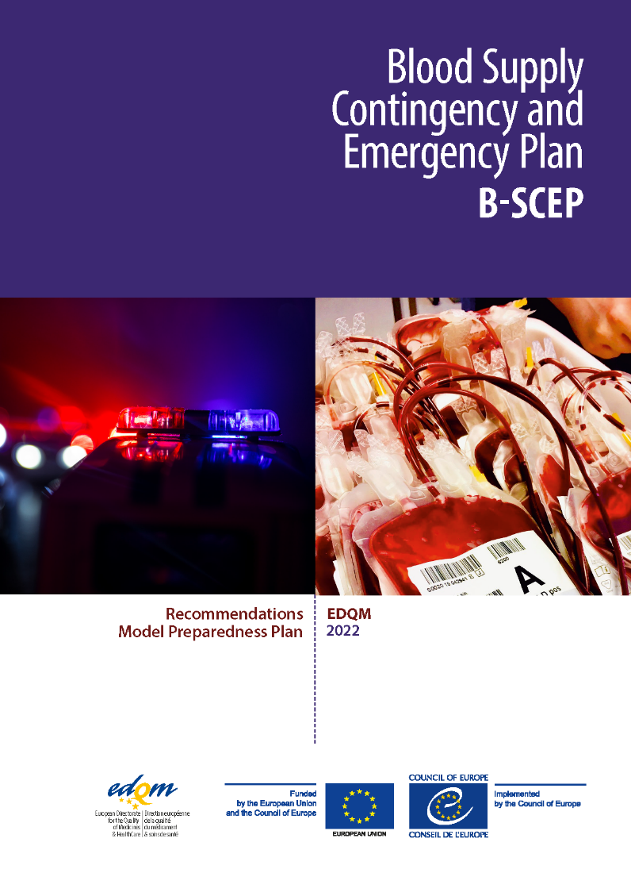
EDQM Blood Supply Contingency and Emergency Plan – 2021 Survey
27 European countries - 78% had plans
Five key risk scenarios (60 % of countries):
Interruptions in the supply and critical service (70 %)
Epidemics/pandemics (70 %)
Disruption or damage to premises or facilities (63%)
Adverse weather conditions (63%)
Terrorist attacks (63 %)
30% (8) Military blood operator function
Armed forces are involved in 41% countries
Notes:
Not every hazard leads to a disaster, not all disasters concern us however they might if they
Suddenly requires a much larger amount of blood than usual
Temporarily restricts or eliminates a blood collectors ability to collect, test, process and distribute blood
Temporarily restricts or prevents the local population from donating blood or restricts or prevents the use of the available inventory of blood products requiring immediate replacement or re-supply of the region’s blood inventory from another region
Creates a sudden influx of donors requiring accelerated drawing of blood to meet an emergent need elsewhere
I would add – anything that leads to lost of trust and reputation
The situation is the same in other countries
This is a key document from the European Directorate for the Quality of Medicines & HealthCare published last year. It follows a survey of 27 European countries
Organisation Responses from national blood establishments and National competent authorities
78% had plans and most of these were coordinated nationally. A wide variety of plans and emergency measures exists but as there is a growing need to co-ordination and collaborate ie there is merit in common approaches
Regional authorities more likely to be involved in countries with a regional blood service. Armed forces were involved in 41%.
The key risk scenarios covered in more than 60%. In some responses this was only done locally rather than in the national plan.
Key risk scenarios vary greatly with individual experience and geographical location of the countries. Therefore, choice of key risk scenarios to be included in the contingency and emergency preparedness plan must be individually assessed by each member state. Both a potential blood supply decrease and blood demand increase should be considered in the contingency and emergency preparedness plan.
The B-SCEP Recommendations and Model Preparedness Plan provide foundations to support European countries in preparedness for emergency situations that may impact the blood supply.
This toolkit can be applied to any blood system, irrespective of organisational setting, and the standardised format facilitates contingency collaborations.
By establishing a B-SCEP, in which key stakeholders and their expected actions are defined for different key risk scenarios, effective mitigation strategies and a rapid response can be implemented.

Slide 12
LESSONS FROM THE FRONTLINES
Notes:
So what lessons can we learn from other frontline industries including the emergency services, safety critical industries and the austere medical environment

Slide 13
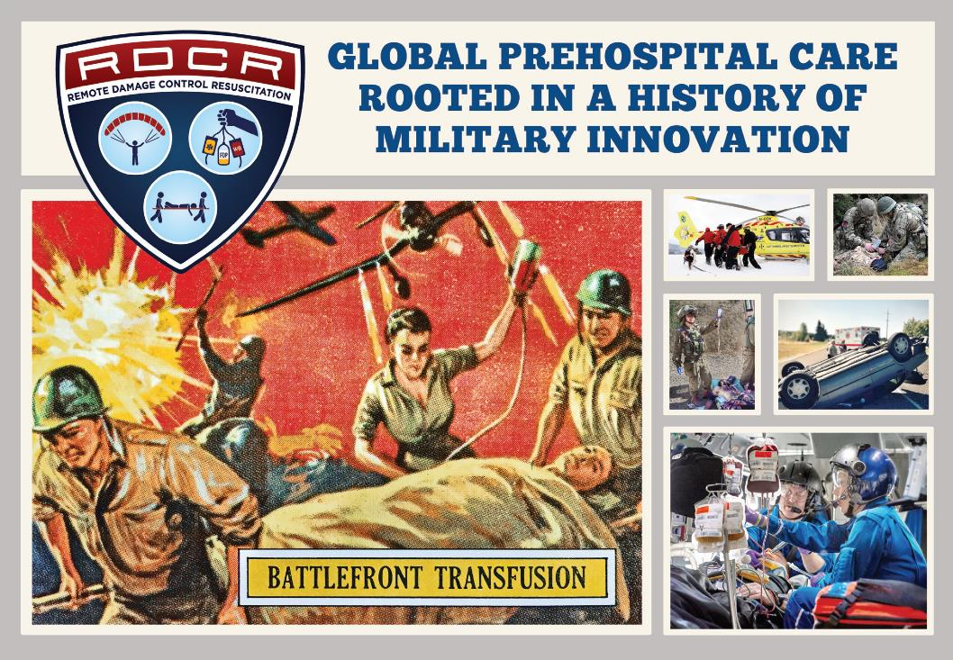
Keep it simple
Stop the bleeding
Resuscitate
Is blood required?
Group O whole blood
Dried plasma
Notes:
The cover image of this Remote Damage Control
Resuscitation 5th Symposium supplement demonstrates “Forward to the Past” principles.
Concepts developed in
WWII but largely abandoned in the 1960s and 70s have been
re-examined, refined and updated, and are now reintroduced
as life-saving interventions:
1. USA: 1965 “Battlefront Transfusion” ToppsVR Battle series
trading card used courtesy of The Topps Company, Inc.
2. Norway: The National Air Ambulance Service transports a
casualty injured in a remote location in Norway.
3. UK: Airborne gunners from the Colchester-based 7th
Parachute Regiment Royal Horse Artillery (7 Para RHA)
apply a compress to a simulated hemorrhaging casualty
during an emergency response training exercise.
4. USA: Paramedics respond to a vehicle collision in a
remote location near Portland, Oregon, courtesy of
Dr. Martin Schreiber.
5. USA: Dr. Donald Jenkins and the Mayo One Team
demonstrate principles of remote damage control
resuscitation (RDCR) aboard a rescue helicopter.
6. Israel: The Israel Defense Forces emergency response
team administers freeze-dried plasma (FDP) in the prehospital
setting to resuscitate a severely bleeding casualty.

Slide 14
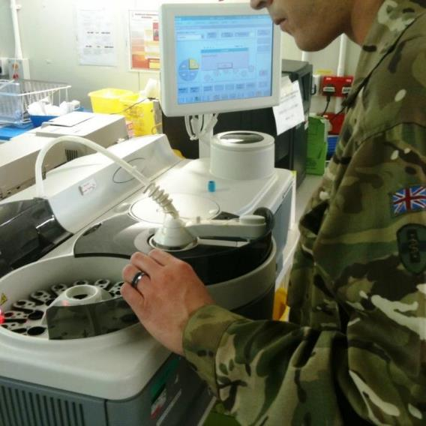
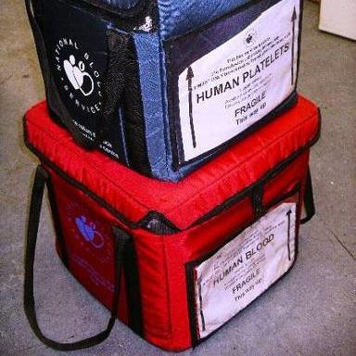
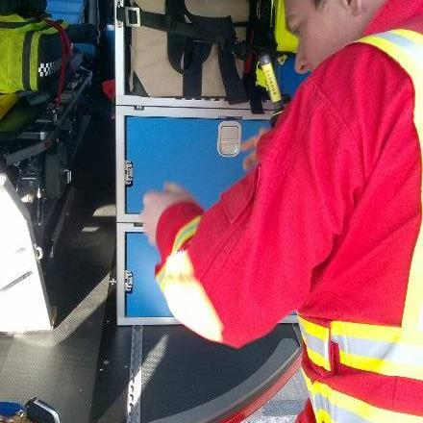
Laboratory, Logistics and Communications
Notes:
The military are often asked for logistic support to emergencies. Here are examples of laboratory support, cold chain and communications
Transfusion support in MCE includes:
Provision of blood and blood components
Blood grouping (and screening for atypical antibodies)
Documentation and regulatory compliance
(Donor management)
Tracebility is a legal requirement
Evidence of Cold chain must be required

Slide 15
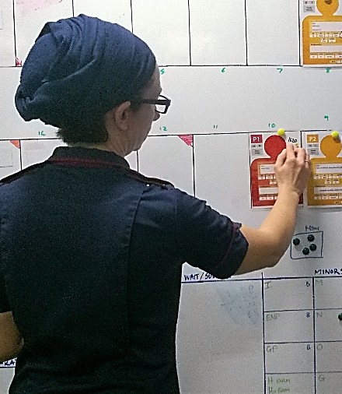
New roles: Transfusion triage and coordinators
Transfusion coordinators: An Emerging role with following responsibilities:
  Transfusion triage
  Laboratory liaison
  Issue of emergency stock
  Handling blood samples
  Training and support
  (Non-medical authorization)
Notes:
We recommend that you appoint
Triage is the prioritization of patient care based on
Injury (severity, prognosis)
Resource availability
A simple example is shown which can be applied at an incident or in hospital
The principle can be used in Transfusion support to prioritise our efforts
Exercising the role of a forward transfusion co-ordinator in Ex Pandora, hospital level exercise with blood service observer, Birmingham, UK, 2017.

Slide 16
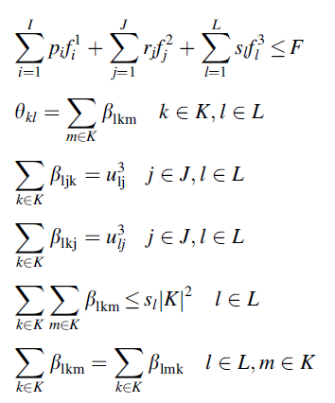

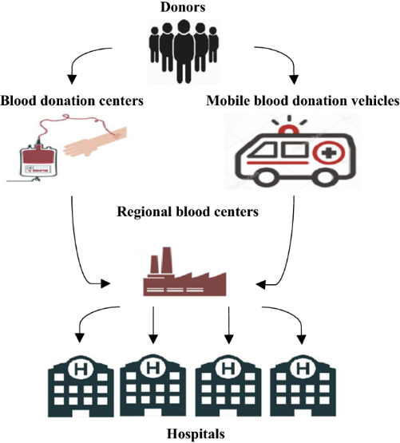
Telemedicine, remote technical support and AI
Notes:
The rapid development of integrated care systems using virtual team meetings, virtual command and control centres, have led to better flow of data both and out.
Previous barriers to sharing health and care records are also dissolving thanks to our coordinated response to Covid-19, The simple fact that everyone has been working together on this has meant we have achieved results previously thought impossible and This is helped by a long-overdue injection of funds from national government.
Turkish Red Crescent Blood Supply Chain Framework
Blood is a vital fluid that can deteriorate quickly which makes the development of precise blood supply chains a fundamental issue. Blood supply chains are systems that carry out the activities of collecting blood from donors,
processing in laboratories, producing, storing and distributing blood products to the people in need. In this regard, blood supply chains can be considered as a human supply chain. Uncertainties in demand and supply, and the
fact that blood is a vital and perishable product, make it difficult to design and plan effective and efficient blood supply chains.
Perhaps we need to be making better use of General-purpose technologies (GPTs) such as ICT and artificial intelligence. When combined with Big Data we could create a much better evidence base for our emergency planning.
General-purpose technologies (GPTs) are technologies that can affect an entire economy (usually at a national or global level) – which may initially have risks but can be harnessed for the benefit of society

Slide 17
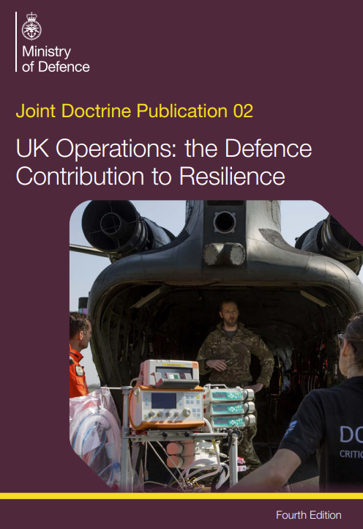

Military aid to the civil authorities
Notes:
The role of the military and the assistance to the civil authorities may be formally included in policy
Here is the 2022 edition of the Joint Defence Publication – available on line.
The provision of military assistance is governed by 4 principles. MACA may be authorised when:
There is a definite need to act and the tasks the armed forces are being asked to perform are clear.
other options, including mutual aid and commercial alternatives, have been discounted; and either
the civil authority lacks the necessary capability to fulfill the task and it is unreasonable or prohibitively expensive to expect it to develop one; or
the civil authority has all or some capability, but it may not be available immediately, or to the required scale, and the urgency of the task requires rapid external support from MOD
The centre of defence pathology played a key supporting role during the recent covid pandemic

Slide 18
POWER of PARTNERSHIP

Slide 19

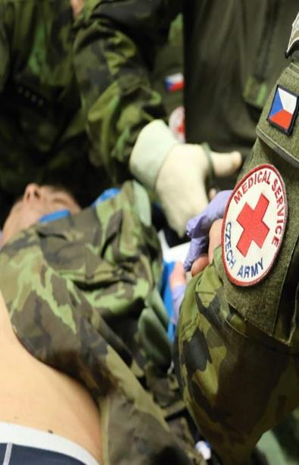
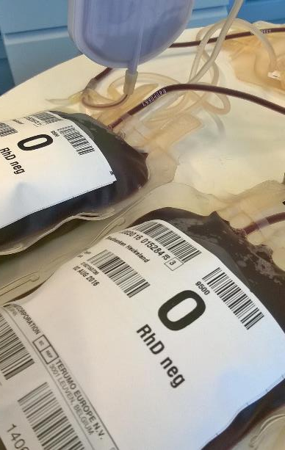
Process, Products, and People
Notes:
WE have seen the innovations in military and civilian medicine used to prevent and protect in emergencies
Examples of new processes such as digitisation, new components but above all the training and new roles for our people
You are the most important element

Slide 20
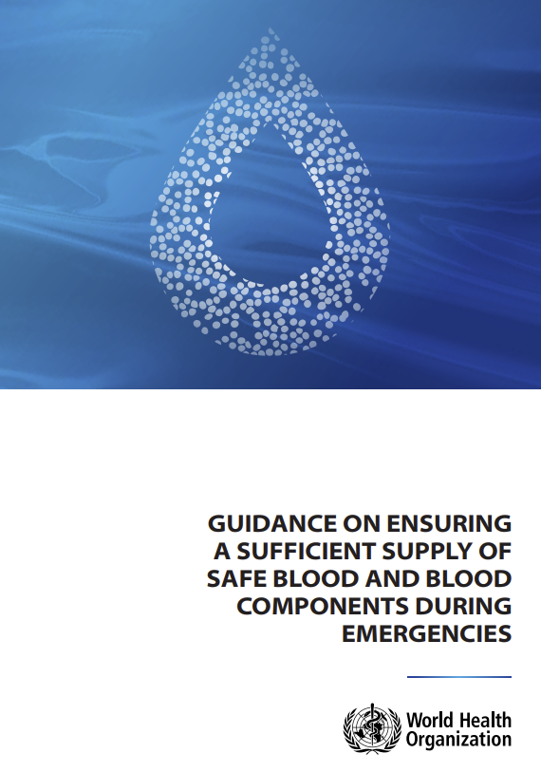
Background
Risk assessment and gap analysis
Emergency preparedness
Response and recovery
Recovery phase
Co-ordinated recovery
Supporting staff
Lessons identified
World Health Organization. (‎2023)‎. Guidance on ensuring a sufficient supply of safe blood and blood components during emergencies. WHO
https://apps.who.int/iris/handle/10665/366870. License: CC BY-NC-SA 3.0
Notes:
The recent WHO guidance provides further examples of global practice and reminds us of the ethical and legal principles in the context of natural disasters and humanitarian emergencies. It is designed to complement existing WHO documents such as Protecting the blood supply during infectious disease outbreaks: guidance for national blood services.
The background section reminds us of our patient communities to be considered when demand planning
The risk section is applied directly to the blood system
The emergency preparedness section includes an excellent example of a Business Continuity checklist
The response and recovery section reminds of to capture lessons identified including use of haemovigilance systems and to care for our most precious resource which is our staff

Slide 21

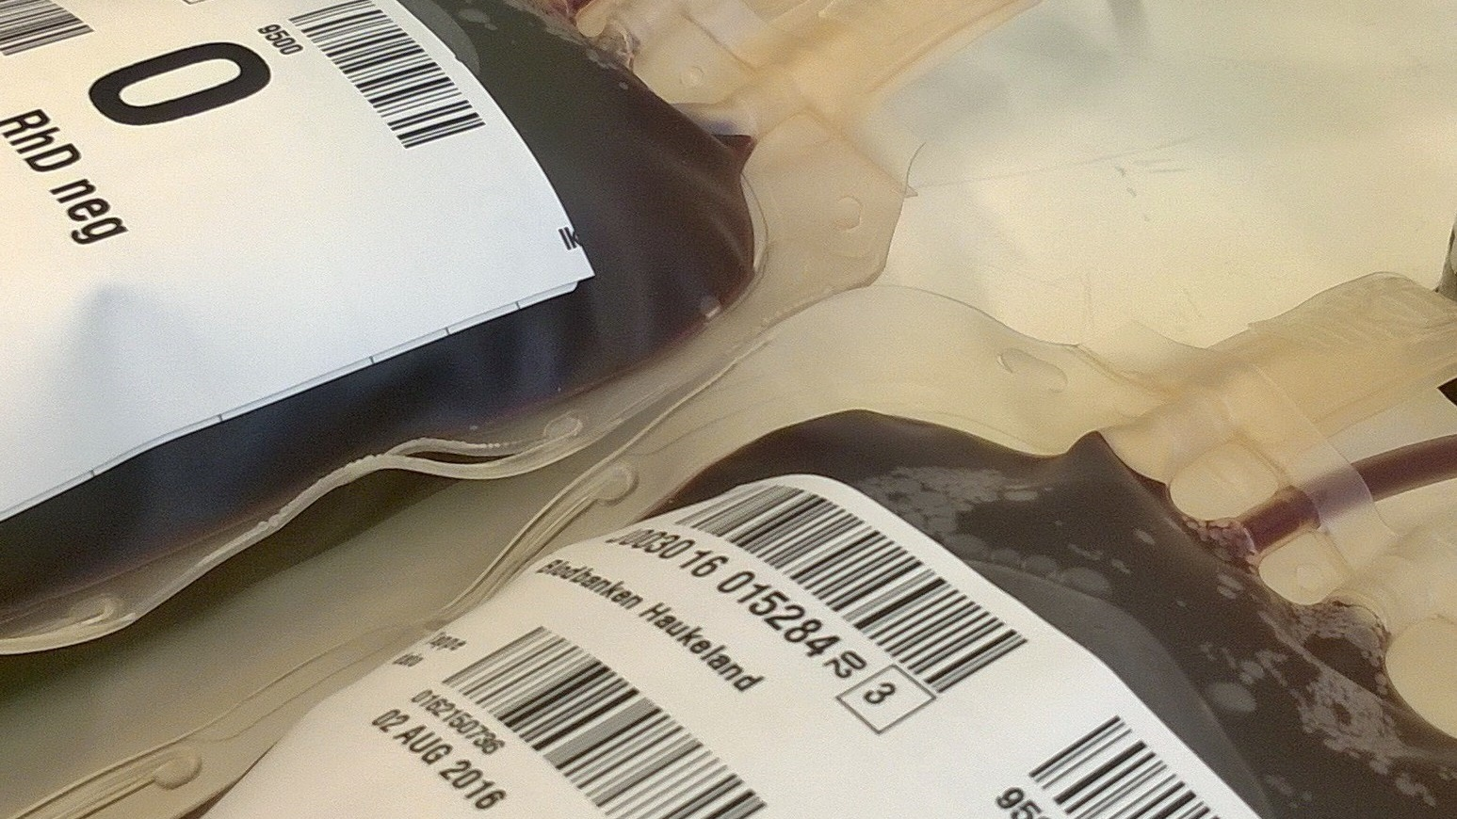
Military
Academic
Civilian
The power of Partnership
Notes:
We learn from each other, civilian, academic and military in a global community
This learning includes building partnerships, which helps to increase local capacity and contribute to institutional change.
This in turn allows society to continually move from vulnerability, adaptation and development to resilience
We can also learn from the Blood Sweat and Tears that are shed to help build a better future

Slide 22
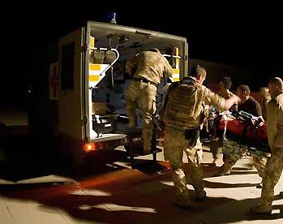
Acknowledgements
Friends and colleagues
Past and present, at
Home and abroad
Notes:
We acknowledge our patients and their families
Our friends and colleagues
Past and present at Home and abroad

